Slide 1


Big data in conservation:
Monitoring bird populations
through volunteer-collected observations
Philipp Boersch-Supan
Ecological Statistician – British Trust for Ornithology
Image: DAVID TIPLING

Slide 2
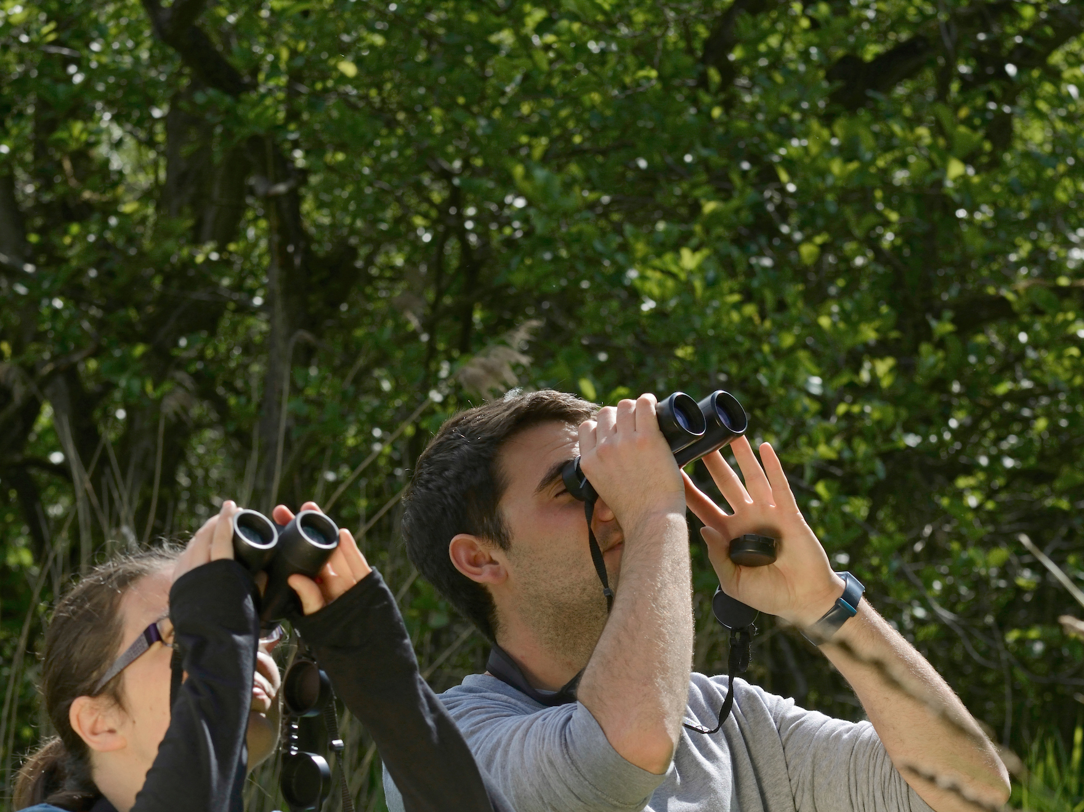
The British Trust for Ornithology
We are an independent charitable research institute
We employ c. 100 staff
c. 50 scientists
c. 50 communicators, fundraisers, volunteer coordinators, administrators, software/database/web developers
We count and ring UK birds with the help of over 40,000 volunteers
We aim to provide impartial evidence to inform the public, opinion-formers and policy- and decision-makers.
Image: DAVID TIPLING

Slide 3
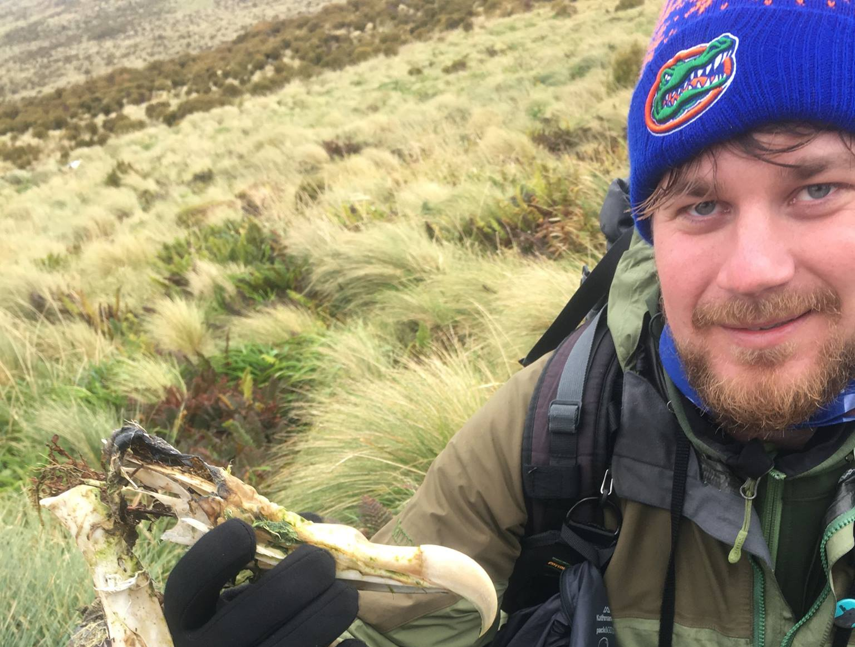
About me
“The statisticians think I'm a biologist.
The biologists think I'm a statistician.
I think it's great.”
Stacey DeRuiter
@pboesu

Slide 4
About me
 |  | Field | Lab | Maths | Stats | Coding
2005 | Field Ornithologist | X
2006-2008 | UG in Chemistry |  | X | X
2008-2009 | MRes in Environmental Biology | X |  | X | X | X
2009-2013 | PhD in Marine Ecology | X | X |  | X | X
2013-2014 | Analyst at British Antarctic Survey |  |  |  | X | X
2014-2018 | Postdoc Quantitative Ecology at Univ. of Florida |  |  | X | X | X
2018- | Ecological Statistician at BTO |  |  |  | X | X
Fell in love with birds
Endured calculus lectures
Learned R, GLMs
A lot more R, GAMs
Wrote my 1st R package
Fell in love with Bayesian methods
More calculus, More R packages
@pboesu

Slide 5
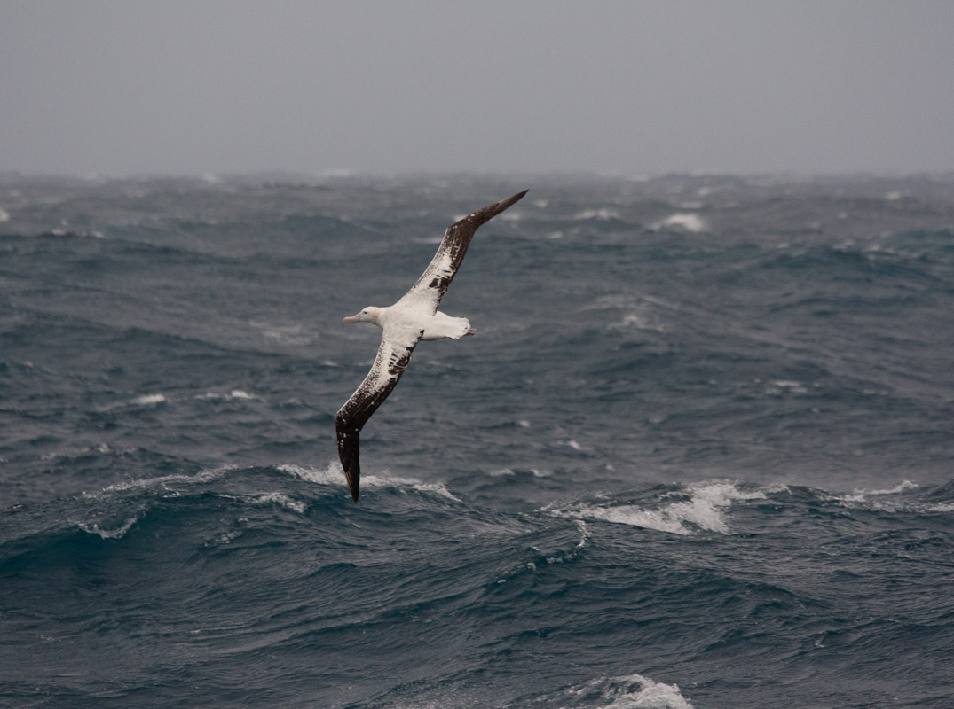
What do I do as an Ecological Statistician?
Notes:
Because that 70% figure concerns the surface of our planet, and so here is my second ocean image, which shows the open ocean from above. Most of the ocean actually looks like this:

Slide 6
- lead to a better understanding of biological processes - allow predictions outside the range of our data - enable informed decisions for conservation actions
I try to build models that
- make the best use of limited (and sometimes ‘messy’) data - are statistically and computationally tractable - use tools/workflows that are easy to reuse and share
Notes:
Because that 70% figure concerns the surface of our planet, and so here is my second ocean image, which shows the open ocean from above. Most of the ocean actually looks like this:

Slide 7
Ecological models @pboesu
Tactical/Phenomenological
Strategic/Mechanistic
Describe patterns
without elucidating
mechanism
Prediction within range of data
Statistical models
(regressions, etc.)
Focus on process/mechanisms
Explanation or understanding
Prediction outside range of data
Math models e.g. ODEs, PDEs
Individual/Agent based Models
Historically largely separate communities within ecology
tendency to ignore ecological theory
& focus on “significance”
tendency to ignore ecological reality & focus on mathematical properties
Inspired by Leah Johnson

Slide 8
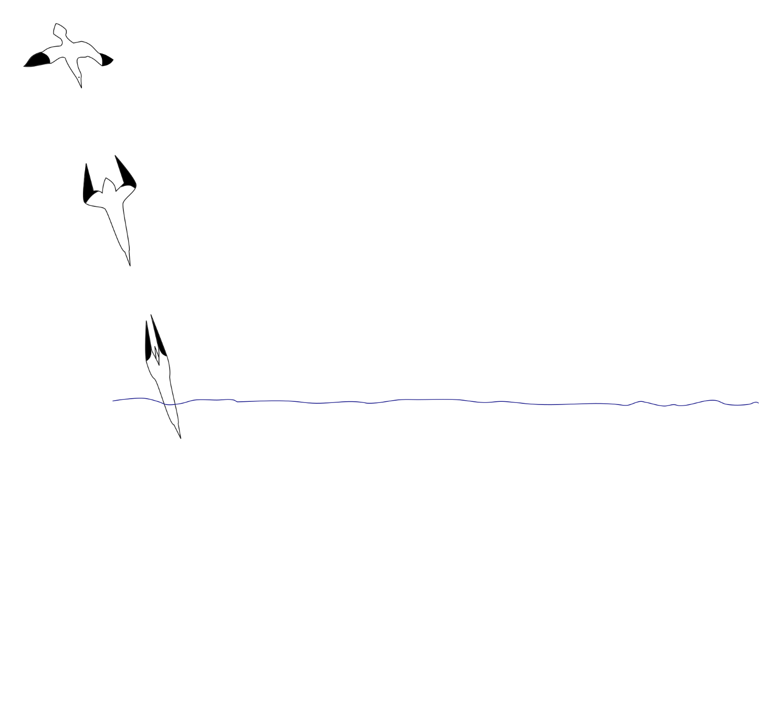
Models in ecology – an analogy @pboesu
Observations
inspired by Maino et al. (2016) Curr Opp Insect Sci

Slide 9
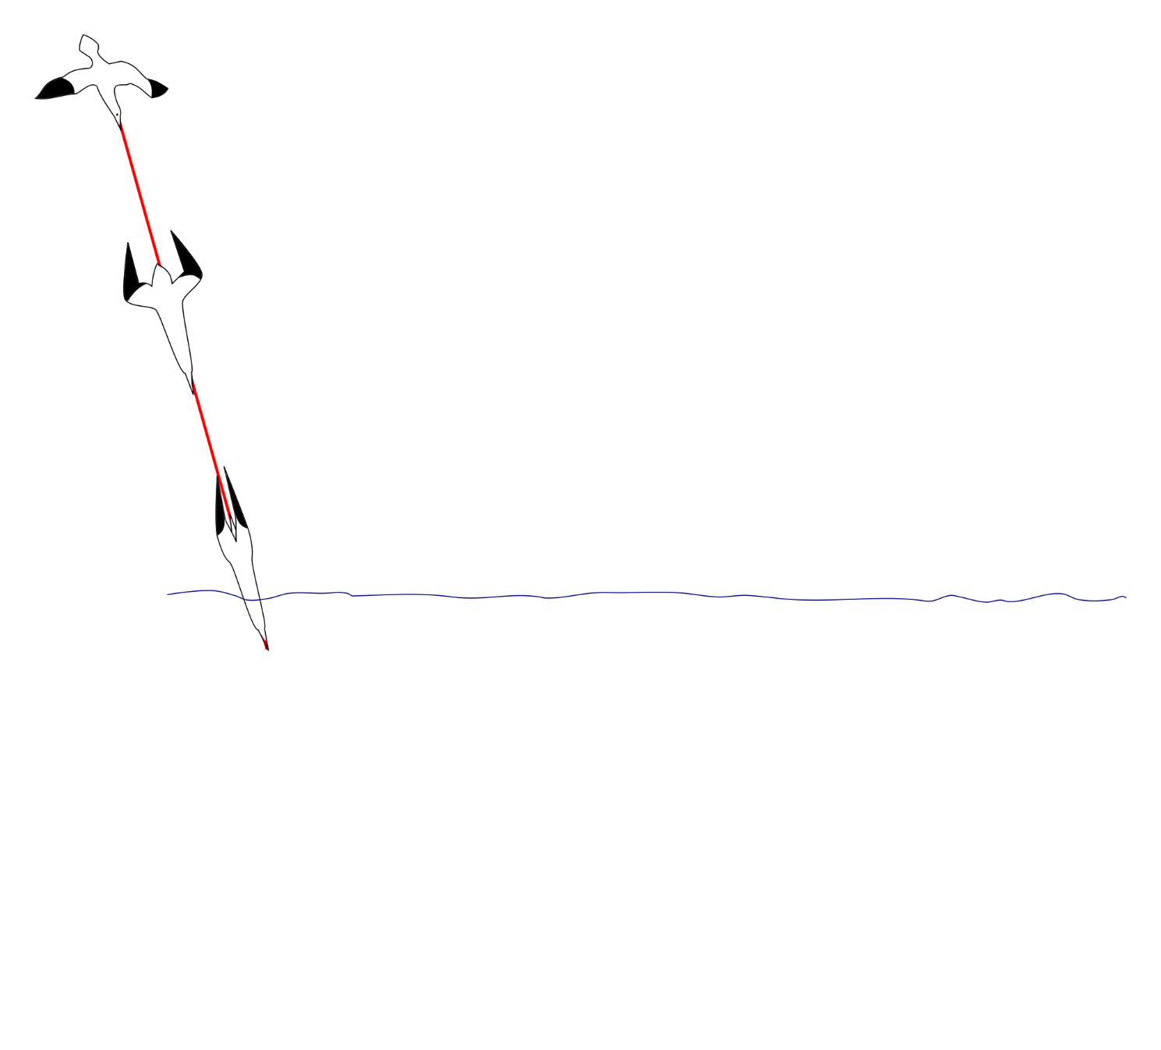
Models in ecology – an analogy @pboesu
Phenomenological models:
Describe patterns without elucidating mechanism
Here e.g.
Regression of altitude ~ time
inspired by Maino et al. (2016) Curr Opp Insect Sci

Slide 10
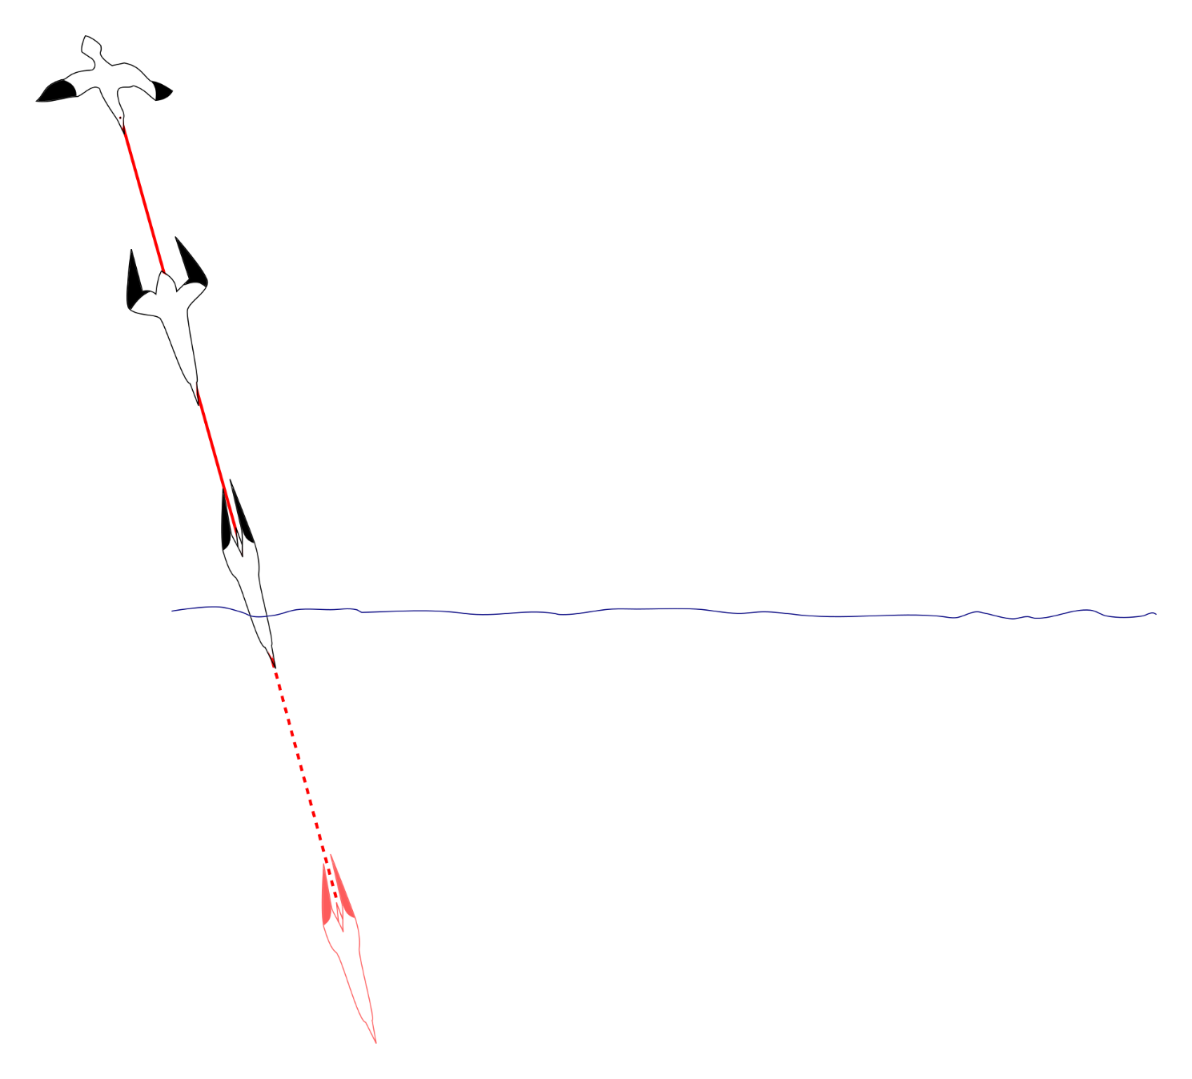
Models in ecology – an analogy @pboesu
Correlative prediction:
May or may not be useful for prediction beyond data
inspired by Maino et al. (2016) Curr Opp Insect Sci

Slide 11
Models in ecology – an analogy @pboesu
Mechanistic models:
Focus on mechanisms, aims at explanation or understanding. Often mathematical models like differential equations.
Here:
Newtonian mechanics, fluid properties
Other examples:
Lotka-Volterra predator-prey models
SIR model in epidemiology
Drag
Gravity
inspired by Maino et al. (2016) Curr Opp Insect Sci

Slide 12
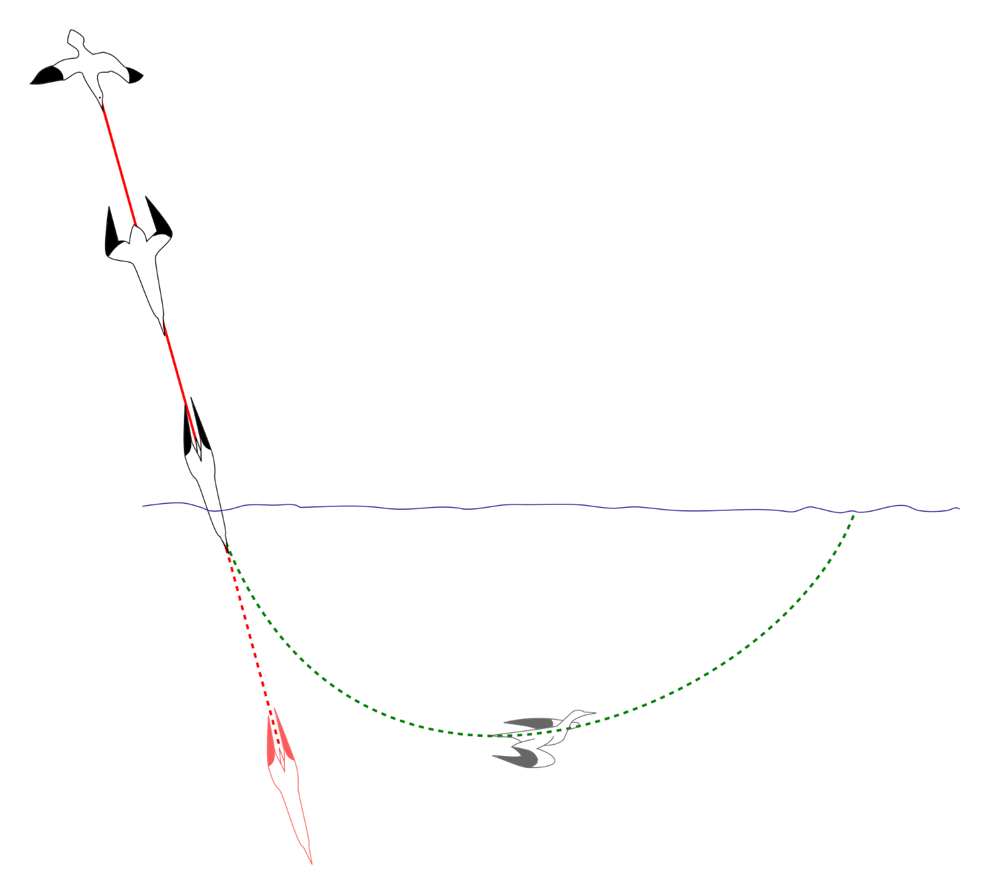
Models in ecology – an analogy @pboesu
Mechanistic prediction:
Can greatly improve prediction beyond data
Buoyancy
Drag
inspired by Maino et al. (2016) Curr Opp Insect Sci

Slide 13
Models in ecology – an analogy @pboesu
Mechanistic prediction:
Can greatly improve prediction beyond data
(If the model is good enough)
Buoyancy
Drag
inspired by Maino et al. (2016) Curr Opp Insect Sci

Slide 14

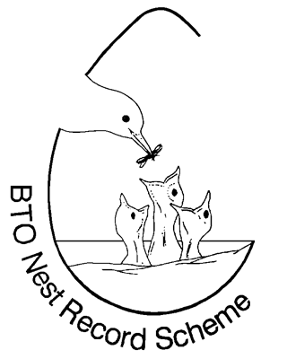

Ecological models - Two case studies from my own work @pboesu
Tactical/Phenomenological
Strategic/Mechanistic
Describe patterns
without elucidating
mechanism
Prediction within range of data
Statistical models
(regressions, etc.)
Focus on process/mechanisms
Explanation or understanding
Prediction outside range of data
Math models e.g. ODEs, PDEs
Individual/Agent based Models
Ringing Schemes
UK Breeding Bird Trends
Integrated Population Models

Slide 15
BTO data collection schemes
Population Monitoring
Breeding Bird Survey
Wetland Birds Survey
Garden Birdwatch
Bird Track
Demographic Monitoring
Ringing Schemes
Nest Records Scheme
Movement and Migration Monitoring
Species-specific tagging projects
Other Surveys
Atlases (~20 year cycles)
Species-specific surveys (e.g. Tawny Owl Surveys)
…

Slide 16
The Breeding Bird Survey
Main scheme for monitoring population changes in common UK breeding birds
Over 100 species covered, including common mammals
Run as a partnership between BTO/JNCC/RSPB
Carried out almost exclusively by volunteers, some professional fieldworkers employed by gov’t agencies
Started in 1994 with 1570 sites
Currently >3900 sites monitored by >2800 volunteers
Results form the basis for several official statistics,
e.g. those mandated by the EU Birds Directive

Slide 17
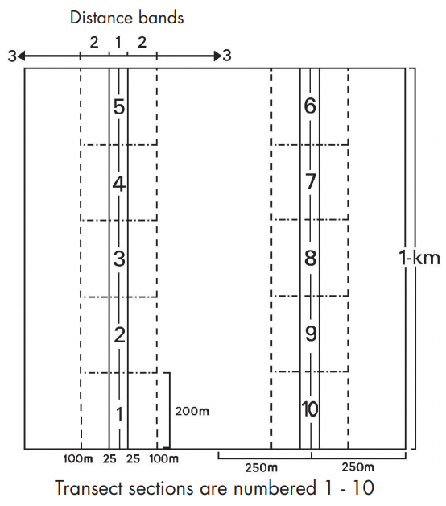
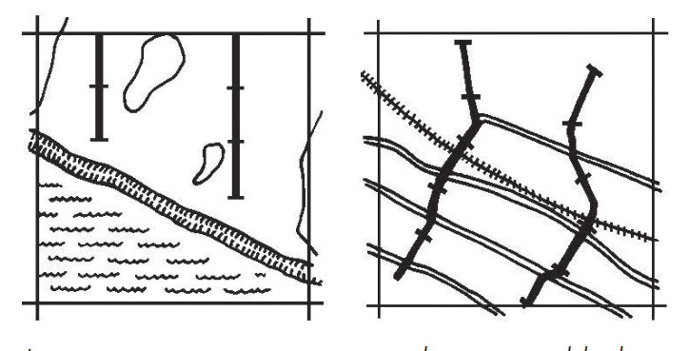
BBS Design
Standardised annual surveys
Randomly selected 1km squares
Two visits per year, 4 weeks apart in April-June
Two distance sampling transects
All birds seen or heard are recorded.

Slide 18
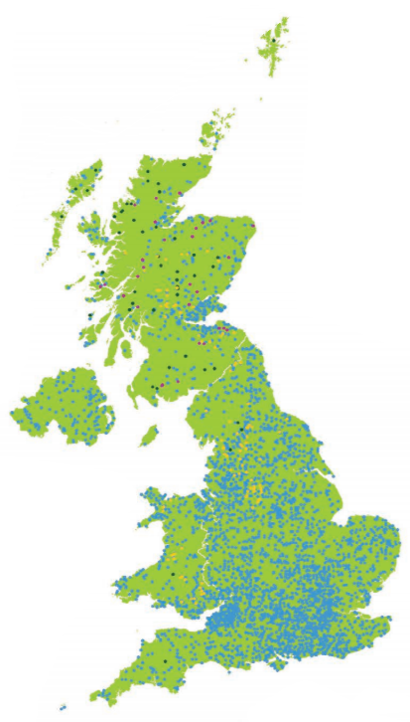
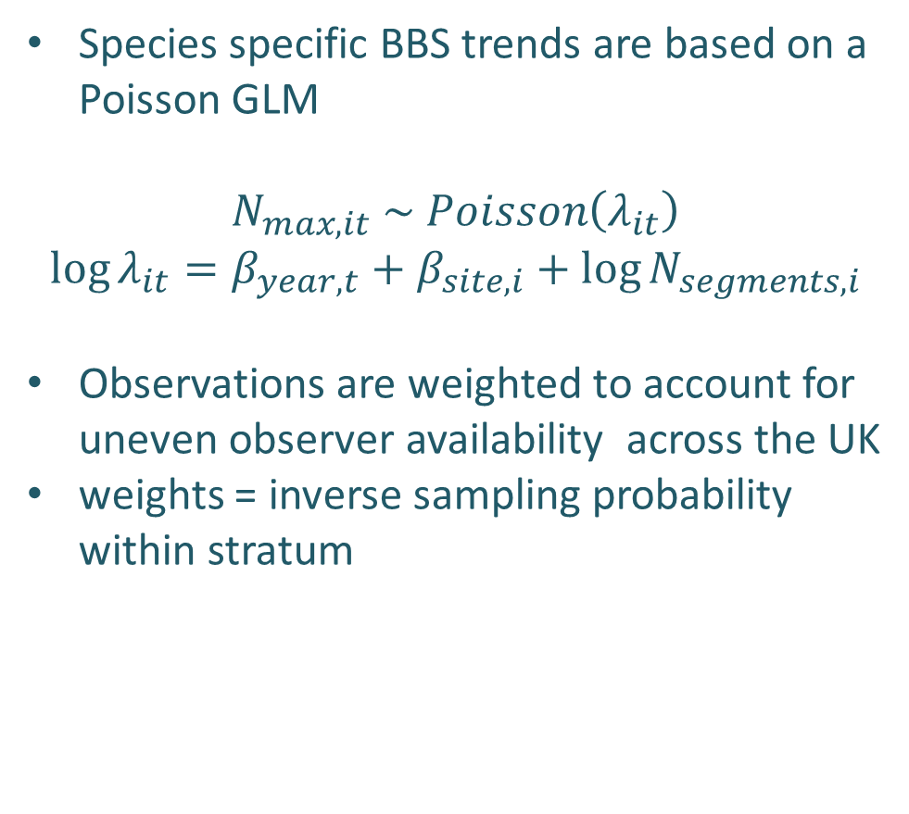
BBS Trends – a descriptive model
Species specific BBS trends are based on a Poisson GLM
$$N_{max, it} \sim Poisson\left(λ_{it}\right)$$
$$\log{λ_{it}=β_{year,t}+β_{site,i}+log{N_{segments,i}}}$$
Observations are weighted to account for uneven observer availability across the UK
weights = inverse sampling probability within stratum

Slide 19
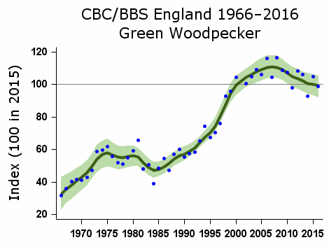
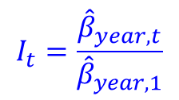
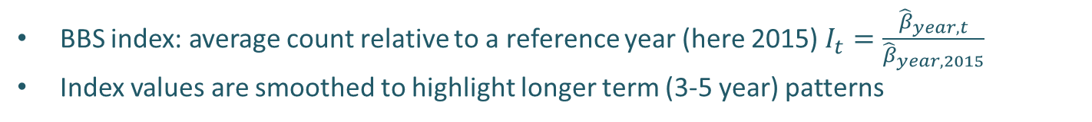
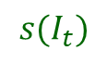
BBS Trends www.bto.org/birdtrends
$$I_{t}=\frac{{\hat{β}}_{year,t}}{{\hat{β}}_{year,1}}$$
bootstrapped CI
$${s(I}_{t})$$
BBS index: average count relative to a reference year (here 2015)$I_{t}=\frac{{\hat{β}}_{year,t}}{{\hat{β}}_{year,2015}}$
Index values are smoothed to highlight longer term (3-5 year) patterns

Slide 20

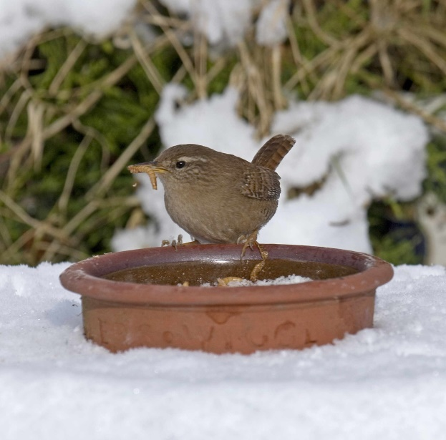
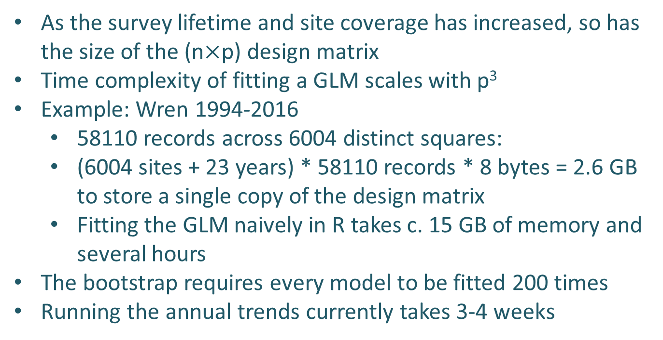
Simple model + big(ish) data ≠ trivial fitting
As the survey lifetime and site coverage has increased, so has the size of the (n$×$p) design matrix
Time complexity of fitting a GLM scales with p³
Example: Wren 1994-2016
58110 records across 6004 distinct squares:
(6004 sites + 23 years) * 58110 records * 8 bytes = 2.6 GB to store a single copy of the design matrix
Fitting the GLM naively in R takes c. 15 GB of memory and several hours
The bootstrap requires every model to be fitted 200 times
Running the annual trends currently takes 3-4 weeks

Slide 21
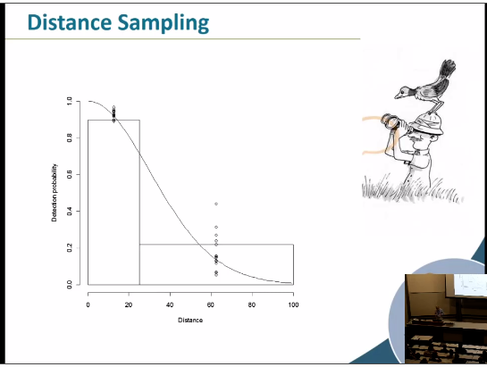
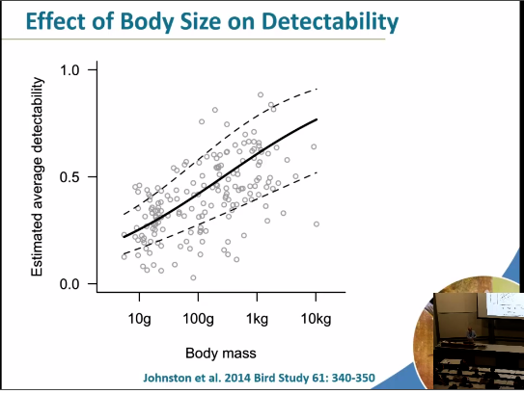
Other uses of BBS data
Absolute population estimates are calculated periodically making use of the distance sampling component
Detection functions are estimated based on counts from 0-25m and 25-100m distance bands
Detection functions differ among habitats, and are trait dependent
Newson et al. 2005 Bird Study, Newson et al. 2008 J Appl Ecol, Johnston et al. 2014 Bird Study

Slide 22
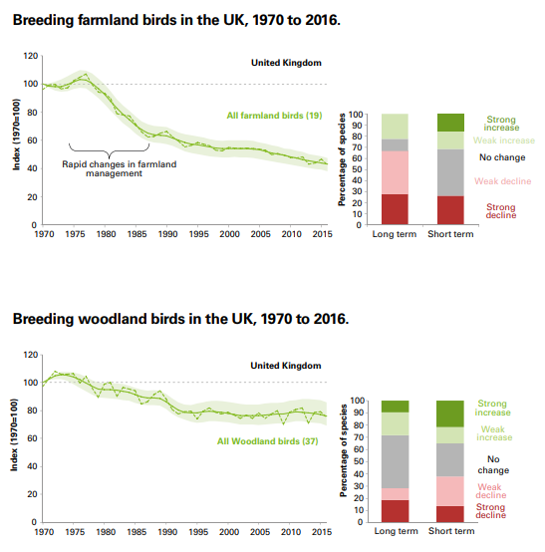
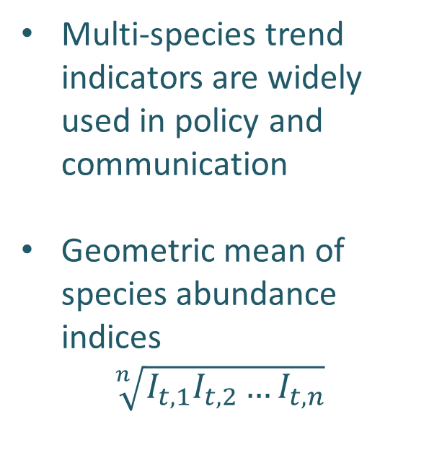
Other uses of BBS data
Multi-species trend indicators are widely used in policy and communication
Geometric mean of species abundance indices
$$\sqrt[n]{I_{t,1}I_{t,2}{…I}_{t,n}}$$
State of the Birds 2017 – RSPB/BTO/WWT/DAERA/JNCC/NE/NRW
Buckland & Johnston 2017 Biol Cons

Slide 23
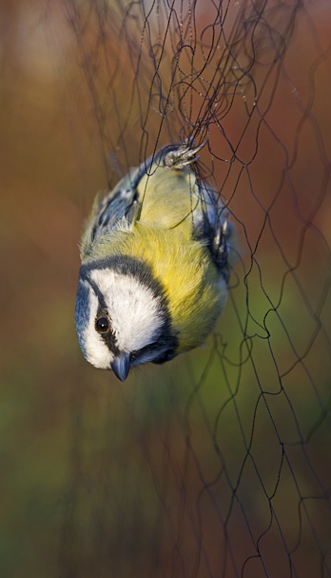
Constant Effort Ringing Sites - CES
BTO issues ringers permits and oversees training in the UK
Qualified ringers are free to ring selected sites
CES is a site-specific structured scheme
Sites are volunteer-selected
mainly reedbed, scrub, woodland
regular habitat management
12 annual capture events, 10 days apart May-August
same nets in same positions
no lures, bait, etc.
all captured birds are processed, focus on 24 songbird species
Image: DAVID TIPLING

Slide 24
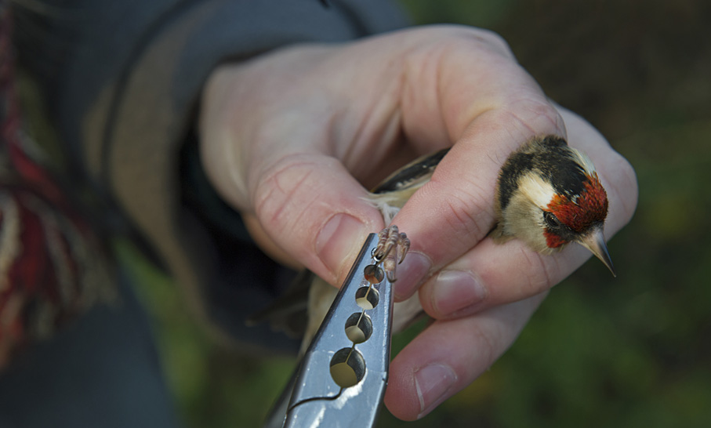
CES Objectives
Measure change in local breeding population size
From adult capture rates
Measure changes in productivity
From juvenile to adult ratios
Measure survival and recruitment
From recaptures across seasons
Image: DAVID TIPLING

Slide 25
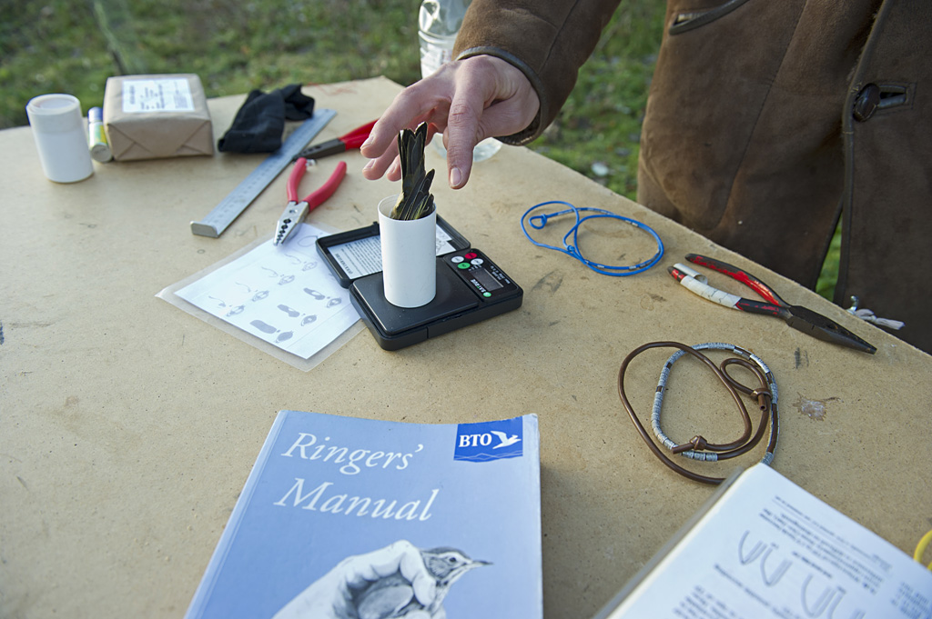
Retrapping Adults for Survival - RAS
RAS is a species-specific structured scheme
Focus on species not well covered by CES
Species and study site are volunteer-selected
Aim is to mark >50 adults annually for at least 5 years
Image: DAVID TIPLING

Slide 26
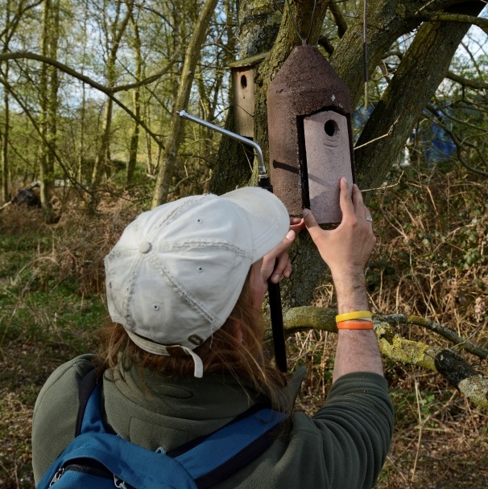
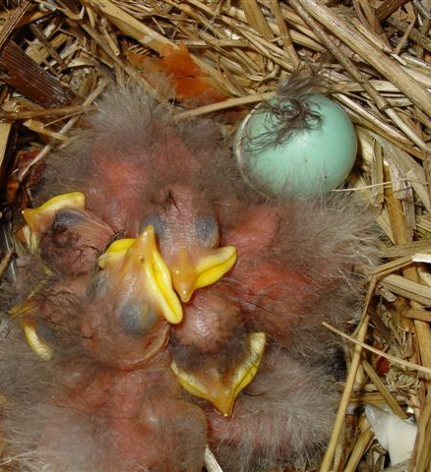
Nest Records Scheme
Volunteer selected sites, species
Multiple visits during the breeding season to record
Nest status
numbers of eggs
Numbers of chicks

Slide 27
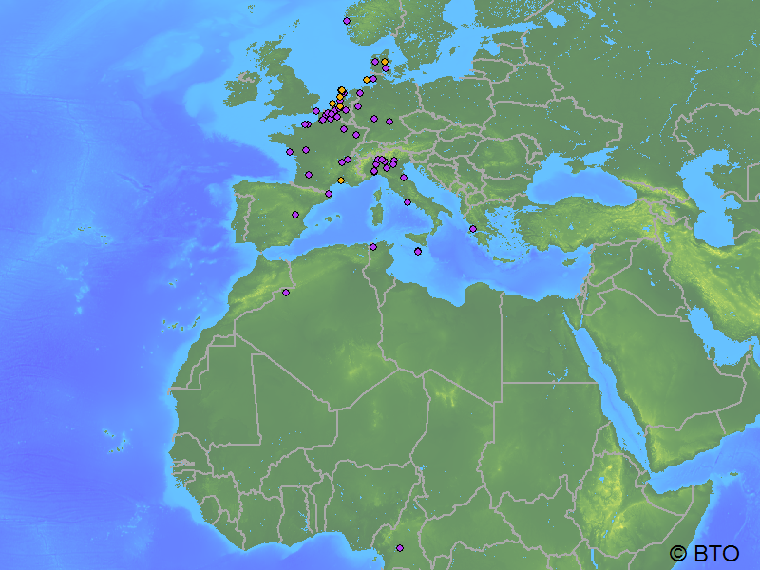
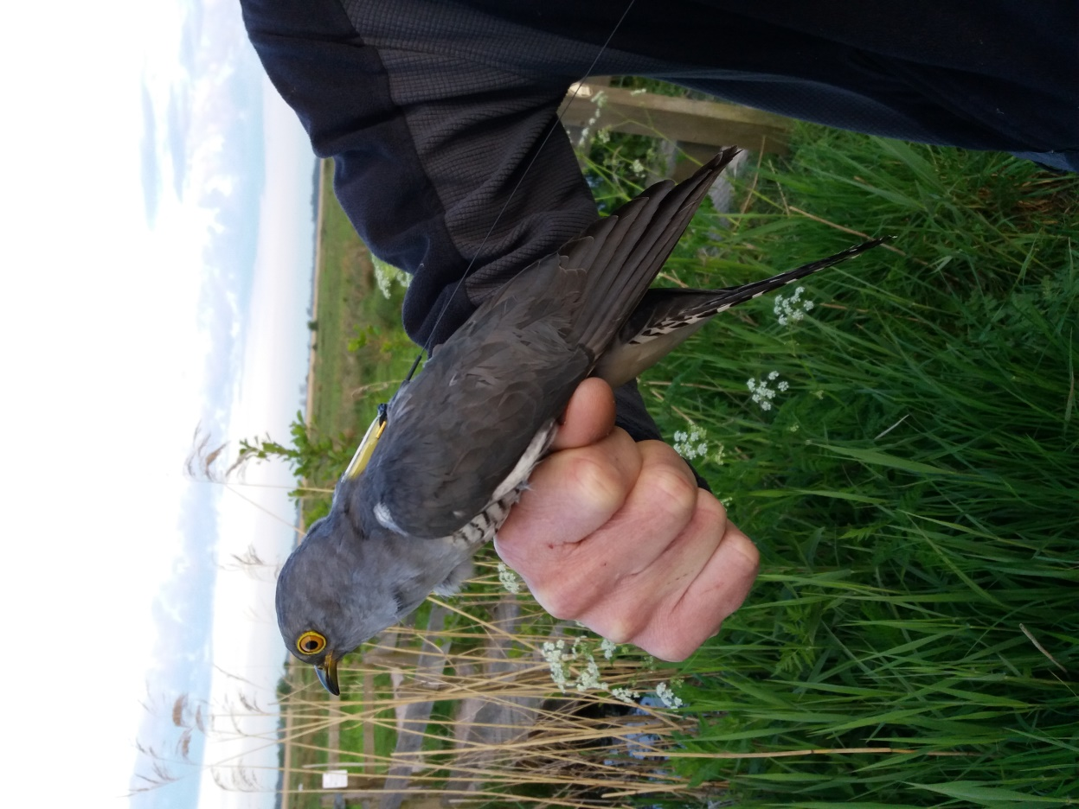
Migration
Original knowledge from ring recoveries/resights
Now increasingly Geolocator/GPS tagging
e.g. Nightingales, Cuckoos, Nightjars, Gulls, Skuas

Slide 28
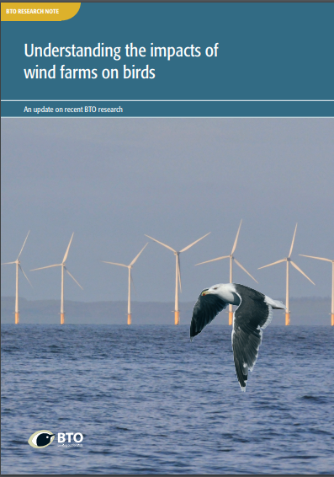
Small scale Movements
GPS/accellerometer tags
Altimeter, LIDAR measurements
Current focus on gulls
Foraging ranges of Urban Gulls
3D space use of gulls in wind farms to assess collision risks
Thaxter et al. 2018 Mar Ecol Prog Ser, Smith-Ross et al. 2016 J Appl Ecol, Johnston et al. 2014 J Appl Ecol

Slide 29


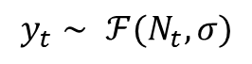
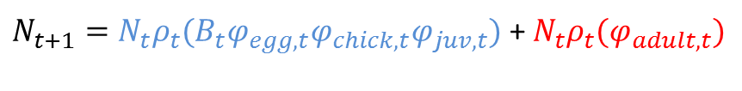
Integrated Population Models
Mechanistic population dynamics models that explicitly account for demographic processes
Brood size B_{t}
Population size
N_{t}
adult survival
ϕ_{adult}
Nest success
ϕ_{egg}, ϕ_{chick}
juvenile survival ϕ_{juv}
Ringing Schemes
counts y_{t}
detectability
State/process model
$N_{t+1}=N_{t}ρ_{t}({B_{t}φ}_{egg,t}φ_{chick,t}φ_{juv,t})$ + $N_{t}ρ_{t}(φ_{adult,t})$
recruitment
survival
Observation model, e.g.
$$y_{t}∼ ℱ(N_{t},σ)$$
Robinson et al. 2014, Methods Ecol Evol

Slide 30
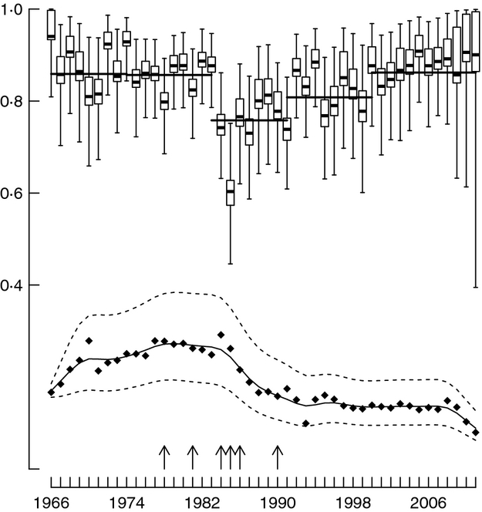
Integrated Population Models
The fitted model provides a biological explanation for the shape of the population trajectory
← Adult survival estimates
← Population trend (not to scale)
arrows indicate hard winters
Robinson et al. 2014, Methods Ecol Evol

Slide 31
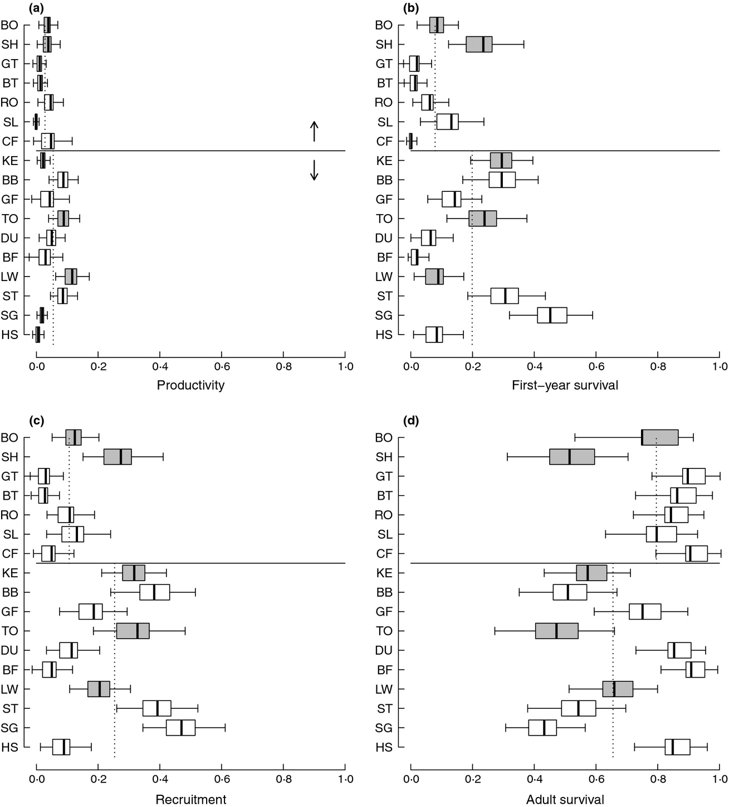
Integrated Population Models
The fitted model provides a biological explanation for the shape of the population trajectory
Pop. increasing
Pop. decreasing
x-axis gives relative contribution to population growth rate of each species
Robinson et al. 2014, Methods Ecol Evol

Slide 32
Limitations of the BBS
Survey design aimed at common, non-colonial diurnal species
i.e. highly detectable, widespread species
Crepuscular and nocturnal birds poorly covered
e.g. owls, nightjars
Uncommon and/or cryptic birds poorly covered
Too few sites and too few visits to achieve a reasonable number of detections
BUT more sites, more visits = more volunteer/surveyor hours

Slide 33
How to overcome BBS limitations?
Can we use unstructured bird listing data from recreational birdwatchers to generate/improve trends for species which are poorly covered by the BBS?

Slide 34
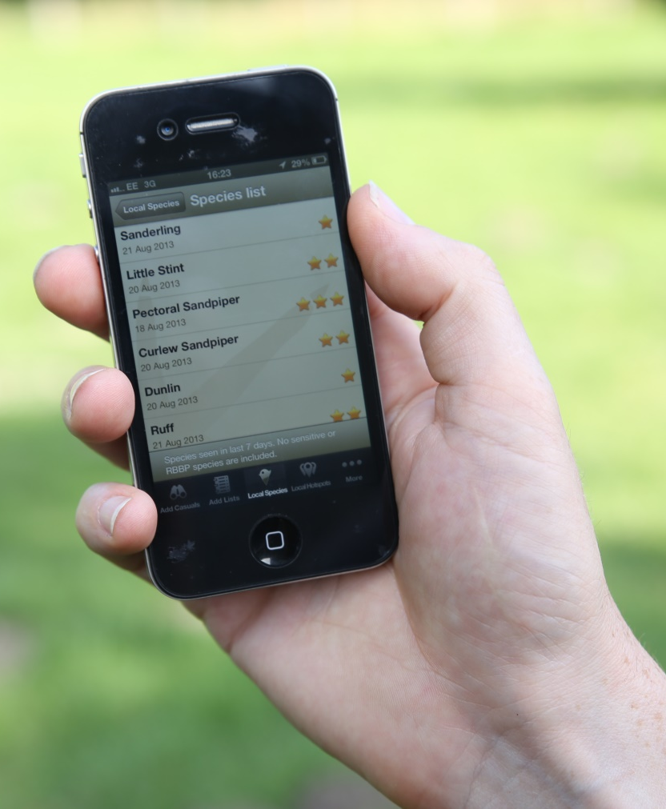
BirdTrack – Big data! (about as big as they come in ecology)
(Web)App for personal bird record keeping
No structured sampling protocol
sites self-selected, self-defined
visit timing, duration self selected
complete listing optional
counting optional
effort recording optional
Similar schemes in many countries / for other taxa
eBird, iNaturalist, etc.

Slide 35
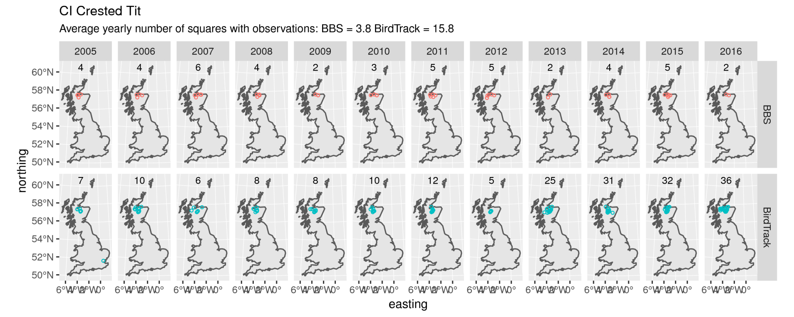
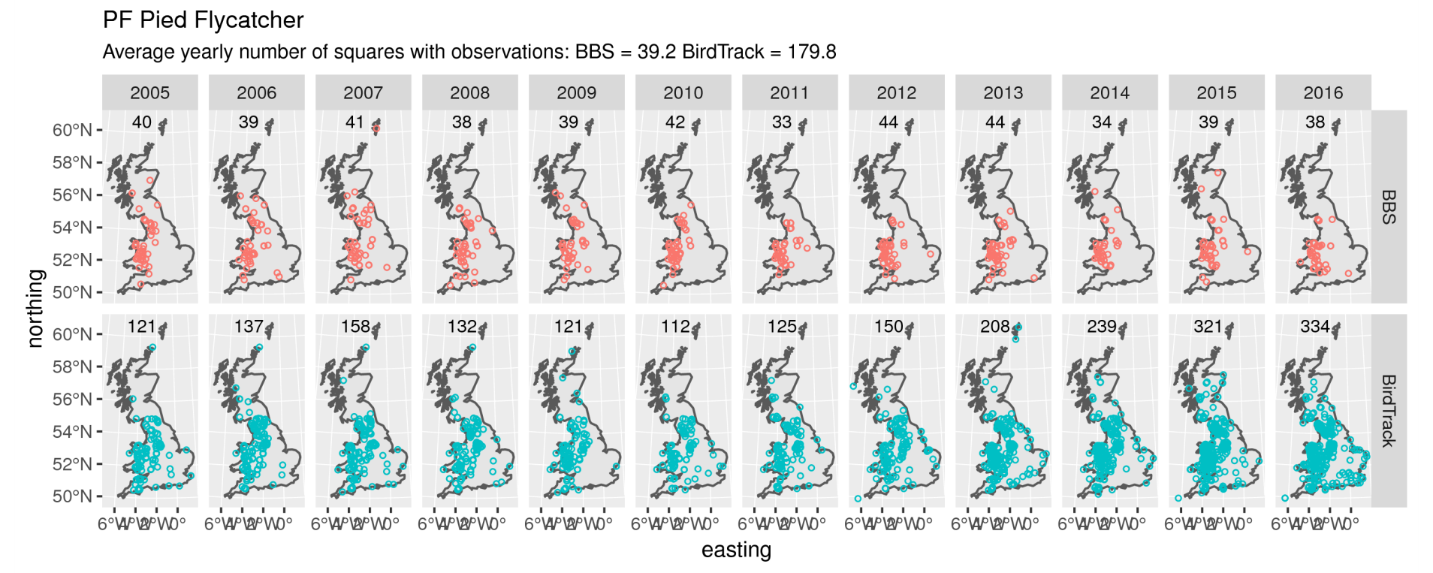
BirdTrack’s big strength: coverage
Notes:
Still better coverage in BT on year-to-year basis, so there is scope for using habitat rather than site-specific covariates, but revisits really important

Slide 36
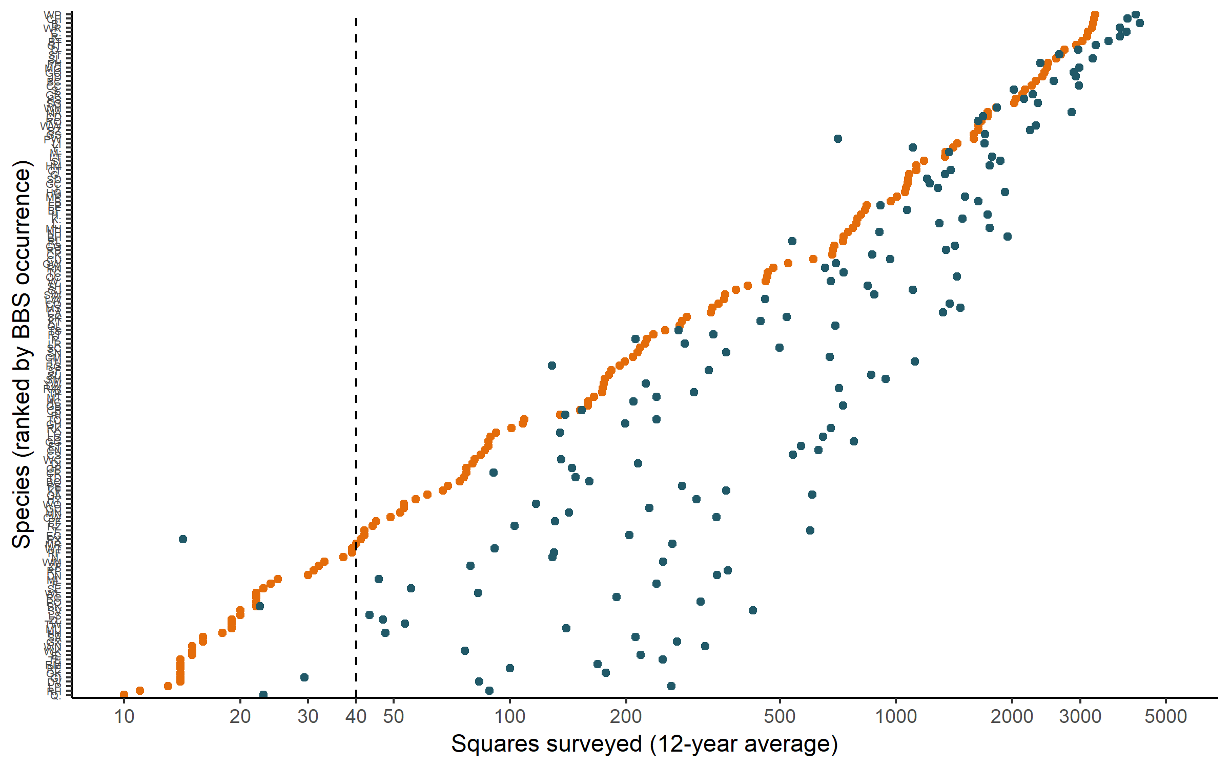
BirdTrack’s big strength: coverage
BBS sample size threshold
BBS
BirdTrack
Pied Flycatcher
Nightingale
Lesser Spotted Woodpecker
Hen Harrier
Woodcock
BirdTrack captures species in many more places than the BBS can

Slide 37
BirdTrack biases
No fixed protocol (timing, area swept, counting etc are optional)
Spatial distribution of sites
Johnston et al. (in review)
BT users predominantly visit locations close to their residence and sites of special interest (e.g. reserves)
BT visit probability can be predicted from habitat/infrastructure variables
Observer skill covariates less well understood
Species identification/omission biases
List starting triggers?
observations do not fulfill the assumptions of the BBS model (random and independent sampling underlying)
More elaborate statistical models are needed to account for bias
“model the birders to model the birds”

Slide 38
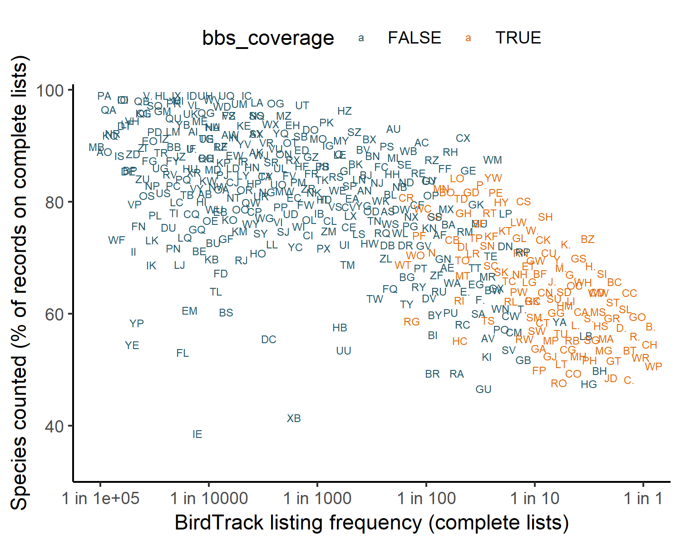
BirdTrack count data
BBS trends
available
No BBS trends
available
Common species are less likely to be counted by BirdTrack users
Where counts are recorded, surveyed area is usually unknown

Slide 39
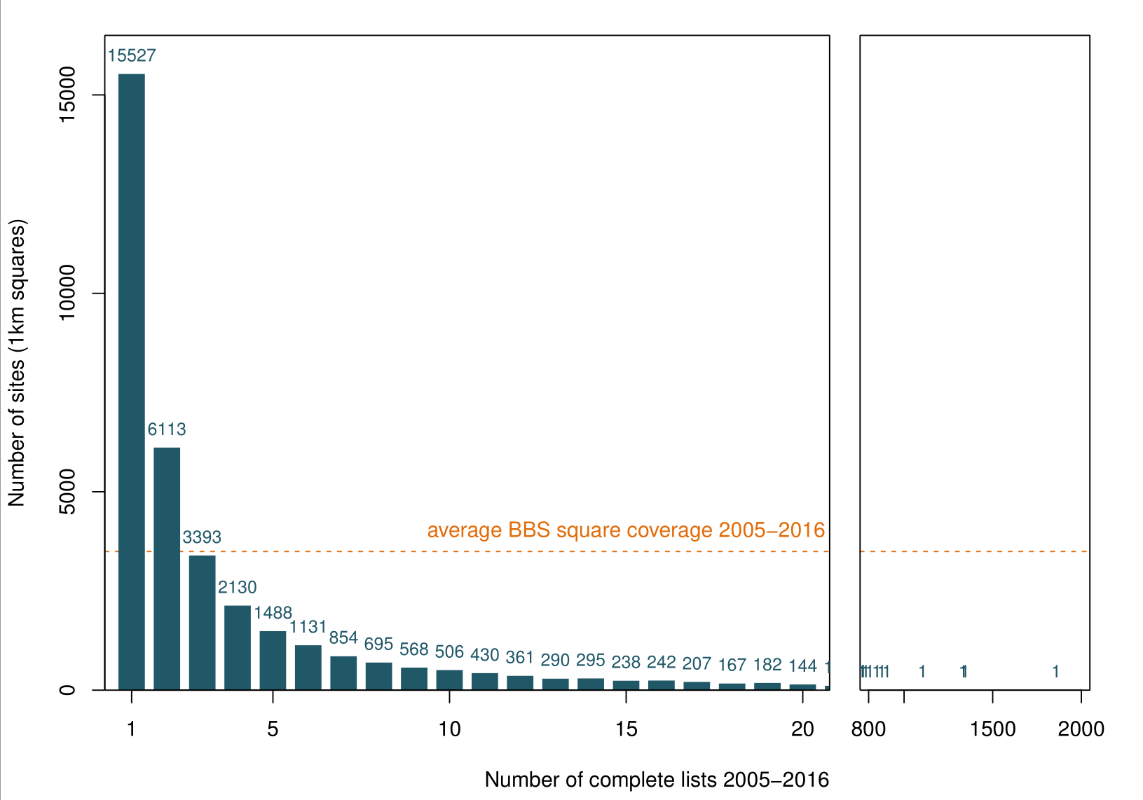
BirdTrack site visit patterns
Repeat lists allow detectability estimation (in theory)
In practice: most sites are rarely revisited
→ technically challenging to fit “off the shelf” models

Slide 40
General Conclusions
Thanks to an enormous volunteer effort bird populations in the UK are among the best monitored globally
National scale wildlife population assessment in practice involves balancing optimal survey designs and cutting edge statistics with limited resources (volunteers, time, software, hardware)
coverage vs. costs / quality vs. quantity trade-offs
Rich datasets can be a technical challenge
But they provide exciting opportunities for methodological developments

Slide 41
Personal Career Conclusions
Interdisciplinary work is fun, but also challenging!
Many opportunities for collaborations
Diverse systems, everything from basic to applied
Hydrothermal vents, deep-sea fishes, elephant seals, penguins, marine microbes, albatrosses, invasive predators, frog diseases, mosquito bite rates, soil biogeochemistry, songbirds, …
Following multiple bodies of literature
Navigating subject-specific workflows/publishing/hiring traditions
Method/software development often seen as service rather than research product; “middle author syndrome”

Slide 42

Thank you to all our volunteers & for your interest!
https://www.bto.org
@_BTO
https://pboesu.github.io
@pboesu
Image: DAVID TIPLING

Slide 43
Further reading suggestions
Ecological Modelling Approaches:
Mouquet et al. 2015 J Appl Ecol https://doi.org/10.1111/1365-2664.12482
Citizen science biodiversity data:
Amano et al. 2016 BioScience https://doi.org/10.1093/biosci/biw022
Kelling et al. 2018 bioRxiv https://doi.org/10.1101/326314
Integrated population models:
Robinson et al. 2014 MEE https://doi.org/10.1111/2041-210X.12204
UK bird trends and other biodiversity assessments:
BirdTrends: bto.org/birdtrends
State of Nature: rspb.org.uk/stateofnature

